Slide 1
LOAN RISK & PERFORMANCE ANALYSIS
PRESENTED BY-
SAYANTAN GHOSH

Slide 2
INTRODUCTION
Purpose
Dataset Overview
Significance of Analysis
Provide an overview of the credit loan dataset and the significance of analyzing it.
Variables Included:
City
Loan Term
Origination Date
Segment
State
Amount
Interest Rate
Risk Rate
Days Overdue etc.
Understanding loan performance and identifying high-risk areas.
Informing strategies to improve loan repayment rates and reduce defaults.
Highlighting regional and segment-based trends to optimize loan offerings.

Slide 3
OBJECTIVES
Primary Objective: Analyze the credit loan data to gain insights for optimizing loan performance and managing risks effectively.
Specific Goals:
Identify patterns to mitigate overdue loans and enhance repayment rates.
Discover business opportunities by analyzing loan issuance and performance across different segments and regions.

Slide 4
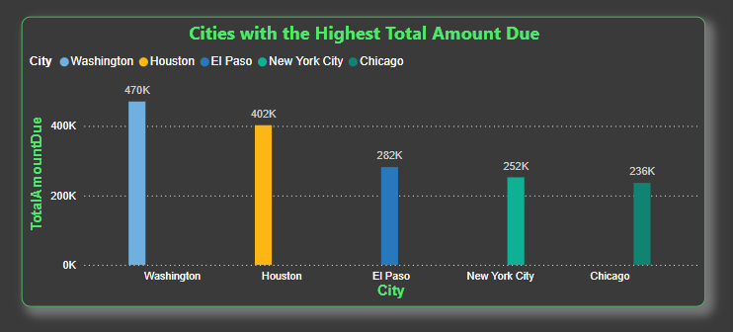
Cities with Highest Total Amount Due
Insight:
Top Cities: Washington, Houston, El Paso, New York City, and Chicago are the top 5 cities with the highest sums of amounts due.
Observation: These cities represent the highest financial exposure in terms of overdue loan amounts, indicating potential areas for focused risk management efforts.

Slide 5
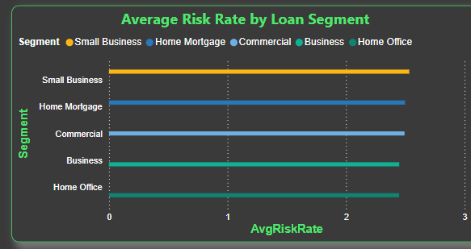
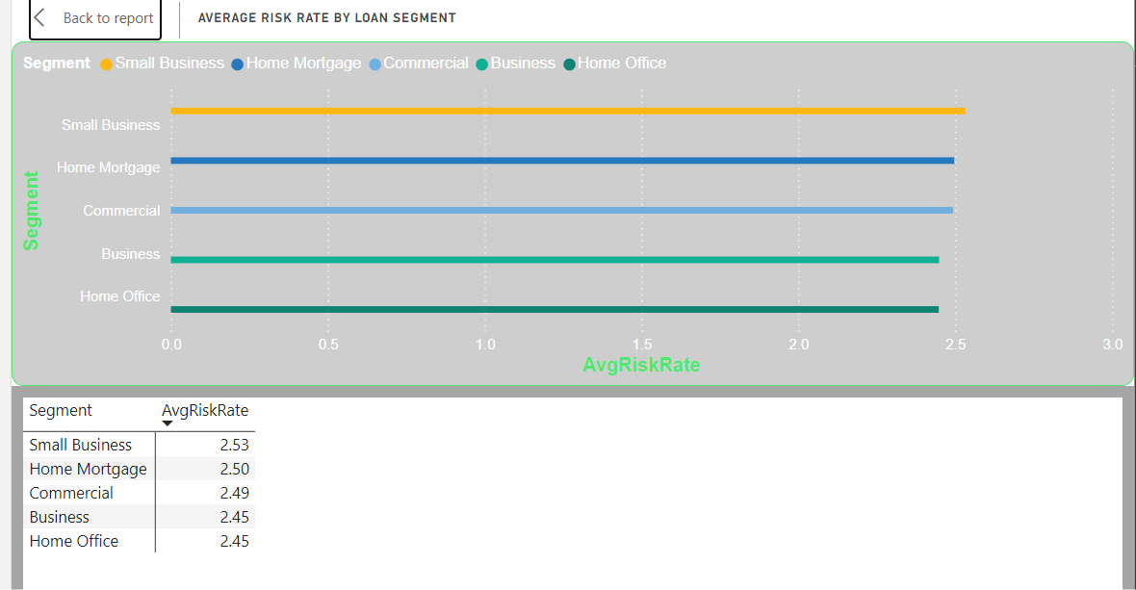
Average Risk Rate by Loan Segment
Insight:
Segment Analysis: Different loan segments such as Commercial, Small Business, Home Mortgage, Home Office, and Personal Loans show varying average risk rates.
Observation: Small Business and Home Mortgage segments have higher average risk rates, indicating these segments are riskier and may require stricter credit policies or enhanced monitoring.

Slide 6
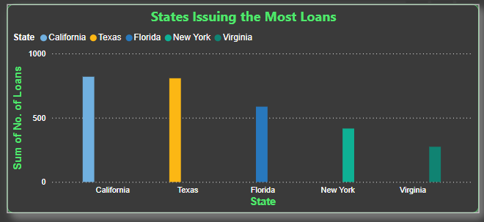
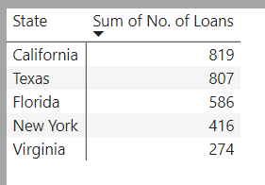
States Issuing the Most Loans
Insight:
State Analysis: California and Texas have issued the most loans, followed by Florida, New York, and Virginia.
Observation: California and Texas are significantly higher compared to other states in the number of loans issued.

Slide 7
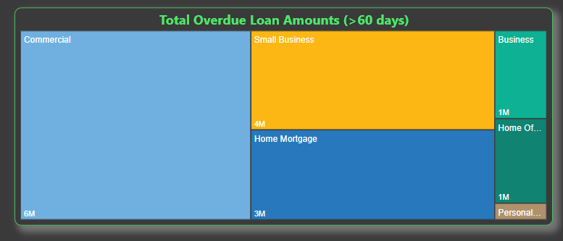
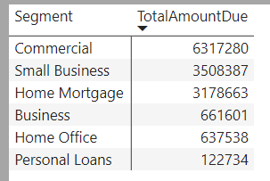
Total Overdue Loan Amounts (>60 days)
Insight:
Overdue Analysis: The treemap visualization displays the distribution of the total overdue loan amounts across different loan segments for loans overdue more than 60 days.
Observation: Commercial, Small Business, and Home Mortgage loan segments contribute most to the overdue amounts. This indicates that these segments have higher financial exposure related to significantly overdue loans.

Slide 8
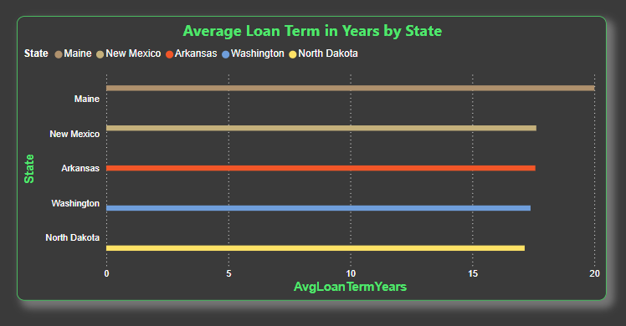
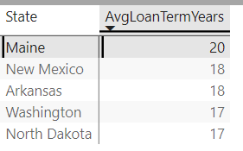
Average Loan Term in Years by State
Insight:
Maine, New Mexico, Arkansas, Washington, and North Dakota have the highest average loan terms.
Maine has the highest average loan term among these states.

Slide 9
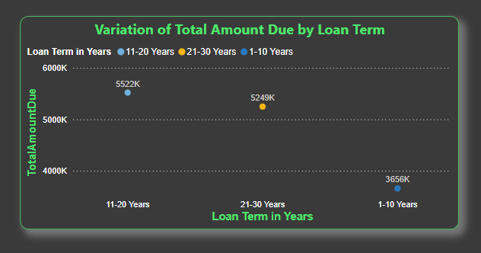
Variation of Total Amount Due by Loan Term
Insight:
When the loan term is 1-10 years, the total amount due is around 3656k.
When the loan term is 21-30 years, the total amount due is around 5249k.
When the loan term is 11-20 years, the total amount due is the highest at around 5522k.
Trend Analysis:
The total amount due increases significantly for loans with terms between 11-20 years and then slightly decreases for loans with terms of 21-30 years. The total amount due is lowest for loans with terms of 1-10 years.

Slide 10
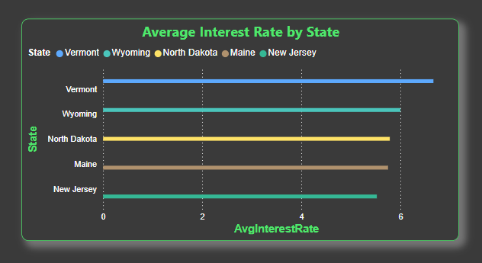
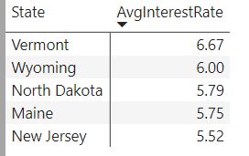
Average Interest Rate by State
Insight:
Vermont, Wyoming, North Dakota, Maine, and New Jersey are the top 5 states with the highest average interest rates.
Vermont has the highest average interest rate among these states.
The variation in interest rates across states can be due to different economic conditions, credit policies, and borrower risk profiles.

Slide 11
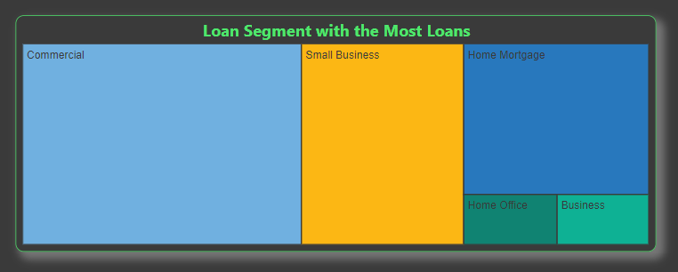
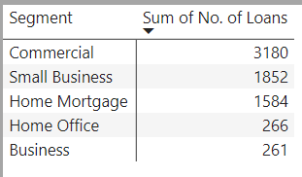
Loan Segment with the Most Loans
Insight:
The segments with the most loans are Commercial, Small Business, and Home Mortgage.
Among these, the Commercial segment has the highest number of loans issued, followed by Small Business and Home Mortgage.
Understanding which segments have the most loans can help in targeting efforts to improve loan performance and risk management.

Slide 12
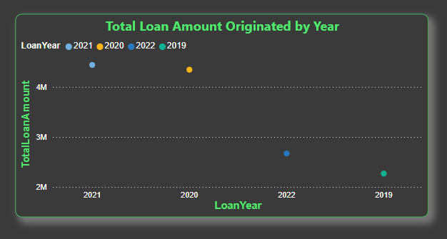
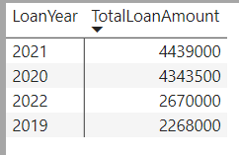
Total Loan Amount Originated by Year
Insight:
In the years 2019 and 2020, the total loan amounts originated were very low.
In contrast, the years 2021 and 2022 saw very high total loan amounts originated.
This indicates a significant increase in lending activity in 2021 and 2022 compared to the previous two years.
Understanding these trends can help in forecasting and planning for future lending activities, possibly indicating economic recovery or other favorable conditions for lending in the later years.

Slide 13
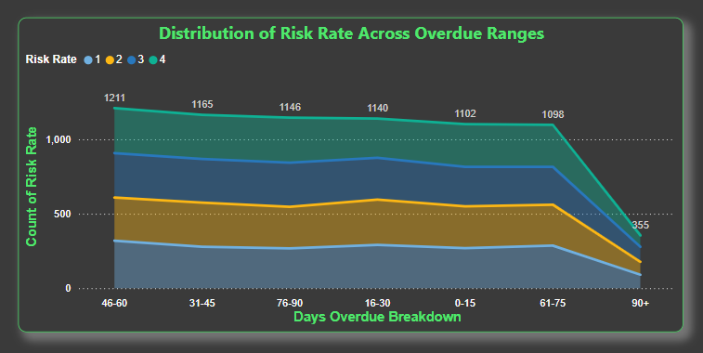
Distribution of Risk Rate Across Overdue Ranges
Insight:
The total count of risk rate is highest when the overdue range is between 46-60 days, peaking at 1211.
The count of risk rate is also relatively high in the ranges of 16-30 days (1146) and 31-45 days (1165).
The count is lower in the 0-15 days (1102) and 61-75 days (1098) ranges.
Notably, there is a drastic decline in the count of risk rate when the overdue range is 90+ days, dropping to 355.
This pattern indicates that most loans become high-risk within the 46-60 days overdue range, but after 90+ days, the count of high-risk loans declines significantly, possibly due to resolution actions or write-offs.

Slide 14
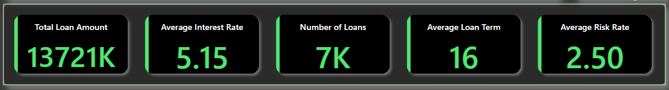
Key Performance Indicators (KPIs)
Represents the aggregate value of all loans.
Shows the mean interest rate across all loans.
Total count of loans issued.
Average duration of loans in years.
Mean risk rate across all loans.
Insight:
These KPIs offer a comprehensive view of loan performance and risk management.
Monitoring these KPIs helps in evaluating lending strategies, pricing, and risk management practices.

Slide 15
Summary of Key Findings
Top Cities for Total Amount Due: Washington, Houston, El Paso, New York City, and Chicago have the highest total amounts due, highlighting areas with significant loan overdue issues.
Riskier Segments: Small Business and Home Mortgage segments exhibit higher risk rates, indicating the need for focused risk management and mitigation strategies in these areas.
States with Highest Loan Amounts: California, Texas, Florida, New York, and Virginia these states also contribute to the highest overdue amounts, emphasizing the need for targeted interventions in high-loan volume states.
Loan Term Impact on Amount Due: Longer loan terms (21-30 years) tend to accumulate higher overdue amounts compared to shorter terms, suggesting that longer-duration loans may carry higher financial risk.
States with High Average Interest Rates: Vermont, Wyoming, North Dakota, Maine, and New Jersey have the highest average interest rates, with Vermont having the highest, impacting overall loan affordability.
Significant Loan Amount Increase in 2021 and 2022: The total loan amounts originated were notably low in 2019 and 2020 but surged in 2021 and 2022, possibly reflecting economic recovery or increased lending activity during these years.
Risk Rate Across Overdue Ranges: The count of high-risk rates peaks in the 46-60 days overdue range and declines sharply in the 90+ days overdue range, indicating critical risk points that require proactive management.

Slide 16
Conclusion
The analysis provides valuable insights into loan performance and risk management. Key findings reveal critical areas for improvement, including managing high overdue amounts in specific cities and states, addressing higher risk segments, and understanding the impact of loan terms and interest rates on overdue amounts. The trends in yearly loan origination also suggest shifts in lending activity that could influence future strategies.
By leveraging these insights, the organization can implement targeted strategies to mitigate risks, optimize loan performance, and enhance overall financial management. Ongoing monitoring and evaluation of these KPIs will be essential for adapting to changing market conditions and ensuring effective risk management.

Slide 17
Next Steps
Targeted Risk Management : Focus on high-risk segments such as Small Business and Home Mortgage. Implement tailored risk mitigation strategies to address the higher risk rates observed.
Geographical Strategy : Develop specific interventions for states with high loan volumes and overdue amounts, particularly California, Texas, Florida, New York, and Virginia. Enhance collection efforts and financial counseling in these areas.
Loan Term and Interest Rate Adjustments : Review loan terms and interest rates, particularly in regions with high average rates like Vermont. Consider adjustments to balance risk and affordability, especially for longer-term loans.
Data-Driven Decision Making : Utilize the insights on loan origination trends and overdue ranges to refine lending strategies and operational practices. Focus on high-risk overdue ranges (46-60 days) for early intervention.
Update Policies and Procedures : Adapt lending policies to address the insights gained, including strategies for handling loans with higher overdue amounts and ensuring compliance with updated risk management practices.

Slide 18
THANK YOU

